Slide 1
COMPETITIVENESS OF LAND RENTAL MARKET AND PRODUCTIVITY GROWTH IN UKRAINIAN AGRICULTURE
Oleg Nivievskyi, oniviev@gmail.com
Kyiv School of Economics (Kyiv, Ukraine)
World Bank Conference “Land and Poverty”
Washington DC, March 2017

Slide 2
Introduction
Farmland market is not fully functional
‘Rental arm’ is the main channel for farmland transactions
‘Sales and purchase arm’ is dysfunctional due to an official ban (moratorium) since 2001
How local farmland market conditions and land governance affect agricultural productivity?

Slide 3
Farmland rental market in Ukraine
The total area of Ukraine is 60.4 million hectares
69% (or 41.6 million ha) is agricultural land
32.5 million ha is arable land
Ownership structure:
30.8 million ha of agland is private
10.7 million ha of agland is in state ownership
Agricultural producers in Ukraine operate mainly on leased land
20 mln ha out of almost 42 mln ha of agrland is leased

Slide 4
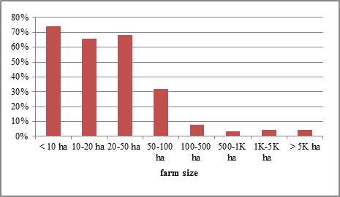
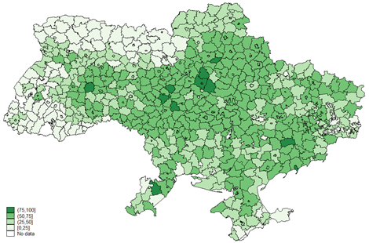
Share of rented farmland land
Larger farmers operate more on rented land, 2014
The share of rented agricultural land in 2014, %

Slide 5
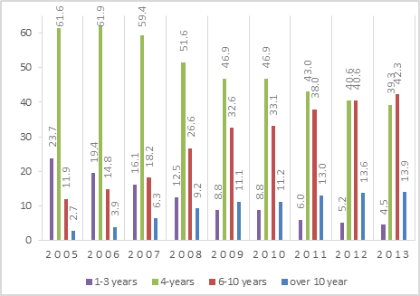
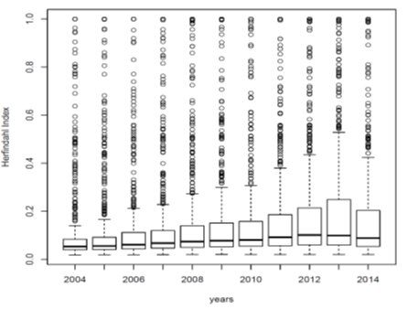
Farmland rental market in Ukraine, cont’d
Rental contracts shifts to a longer duration
Gradual increase of land use concentration, Herfindile index

Slide 6
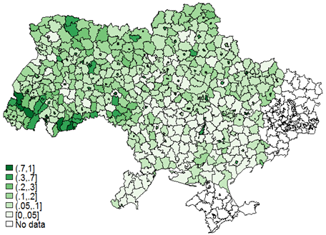
Signs of local monopolies, Herfindile concentration index

Slide 7
Two stage estimation approach
First stage:
estimate Cobb-Douglas Production Function using farm-specific fixed effect panel regression
Data: is a balanced panel of 17000 farms over the period 2013-2014
District-level effect is calculated as an average of farm-specific fixed affects: proxy for common time-invariant rayon-level characteristics
Second stage:
semi-parametric regression to model the determinants of the district-level productivity effects in Ukraine

Slide 8
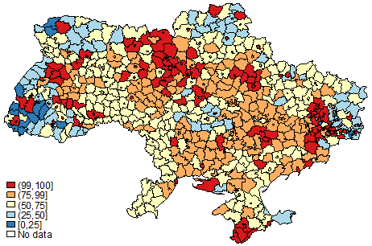
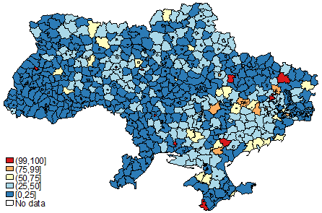
District-level Productivity Determinant: Registration in the Land Cadastre
Share of private land registered in the State Land Cadastre, %
Share of state land registered in the State Land Cadastre, %

Slide 9
Other District-Level Productivity Determinants
Local Farmland Rental Market Structure: Herfindile Concentration Index
Rayon land area
Average private parcel size and Average state parcel size
Density of rayon population per agricultural area (demand proxy)
Share of state and private rented land
Share of state ag. Land
Shares of forest, water and irrigated land

Slide 10
Results
Farmland market concentration undermines productivity
Rayons with less state have higher productivity

Slide 11
Results
For larger state land plots, the larger productivity disadvantages
The size of private ag.land does not affect productivity

Slide 12
Results
Rayons with more state land are more disadvantaged
Highly non-linear effect of state land registration

Slide 13
Conclusion
How local farmland market conditions and governance variables affect productivity
Virtually all determinants revealed significant degree of non-linearity
Local farmland market concentration negatively effects productivity
Productivity disadvantages are strongly associated with the state land

